Slide 1

Open source software tools for FPGA developments
Brahim HAMADI CHAREF Scientist, IHPC / A*STAR

Slide 2
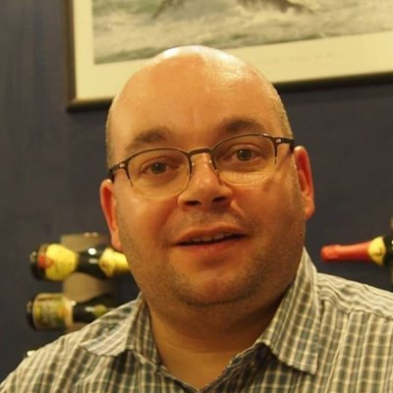

Brahim HAMADI CHAREF
B.Eng EE, M.Eng IE, PhD Audio DSP
Scientist, Computing and Intelligence (CI) Department
Institute of High Performance Computing (IHPC)
Agency for Science, Technology and Research (A*STAR)
https://www.linkedin.com/in/bhamadicharef/
https://twitter.com/BHamadicharef

Slide 3
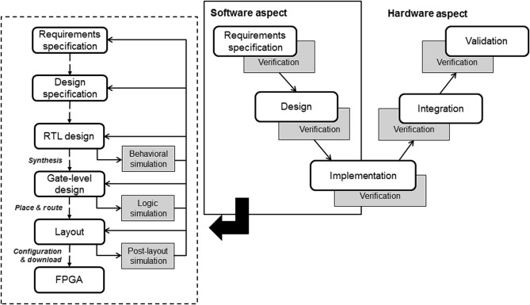
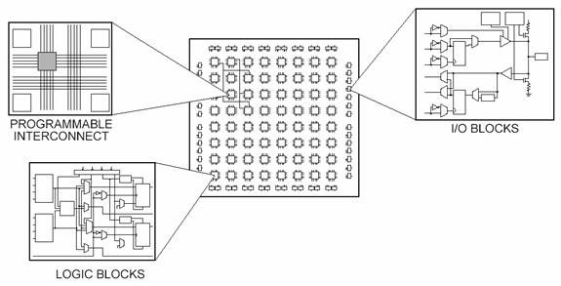
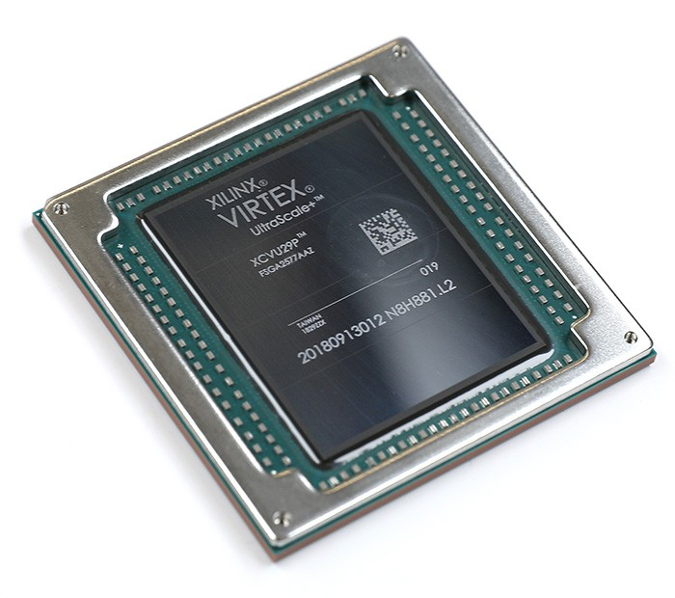
FPGA Development Cycle
Field Programmable Gate Array (FPGA)
Register-transfer-level (RTL) design is about creating digital logic circuits using hardware description languages like Verilog HDL, VHDL
An Integrated Software Testing Framework for FPGA-Based Controllers in Nuclear Power Plants Jaeyeob Kim, Eui-Sub Kim, Junbeom Yoo, Young Jun Lee, Jong-Gyun Choi Nuclear Engineering and Technology Volume 48, Issue 2, April 2016, Pages 470-481 https://doi.org/10.1016/j.net.2015.12.008

Slide 4
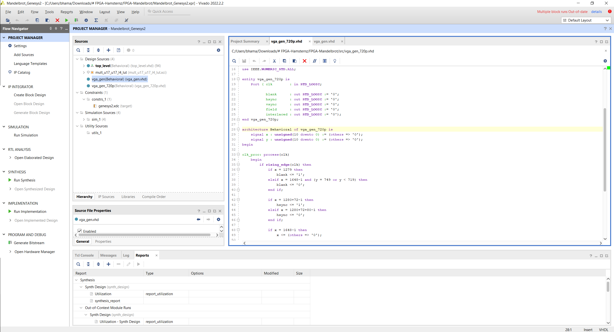
FPGA Development Tool
(ALL FREE)
Xilinx (AMD) Vivado Altera (Intel) Quartus Lattice Diamond GoWin EDA

Slide 5
Yosys+nextpnr FCCM2019 Paper
Yosys+nextpnr: an Open Source Framework from Verilog to Bitstream for Commercial FPGAs David Shah, Eddie Hung, Clifford Wolf, Serge Bazanski, Dan Gisselquist, Miodrag Milanović Proceedings of the 2019 IEEE 27th Annual International Symposium on Field-Programmable Custom Computing Machines (FCCM) April 28 2019 to May 1 2019 San Diego, CA, USA DOI: https://doi.org/10.1109/FCCM.2019.00010 arXiv: https://arxiv.org/abs/1903.10407 Abstract: This paper introduces a fully free and open source software (FOSS) architecture-neutral FPGA framework comprising of Yosys for Verilog synthesis, and nextpnr for placement, routing, and bitstream generation. Currently, this flow supports two commercially available FPGA families, Lattice iCE40 (up to 8K logic elements) and Lattice ECP5 (up to 85K elements) and has been hardware-proven for custom-computing machines including a low-power neural-network accelerator and an OpenRISC system-on-chip capable of booting Linux. Both Yosys and nextpnr have been engineered in a highly flexible manner to support many of the features present in modern FPGAs by separating architecture-specific details from the common mapping algorithms. This framework is demonstrated on a longest-path case study to find an atypical single source-sink path occupying up to 45% of all on-chip wiring.

Slide 6
Yosys Open SYnthesis Suite
Framework for RTL synthesis tools https://yosyshq.net/yosys/
Can be fully built from source
Verilog and SystemVerilog supported VHDL using GHDL https://github.com/ghdl/ghdl
YosysHQ - yosys https://github.com/YosysHQ/yosys
YosysHQ additional projects - SymbiYosys (SBY) is a front-end for Yosys-based formal verification flows - Many other projects like Trellis for ECP5 FPGAs - PicoRV32 implementing the RISC-V RV32IMC (Base Integer Instruction Set, M Standard Extension for Integer Multiplication and Division, and C Standard Extension for Compressed Instructions)

Slide 7
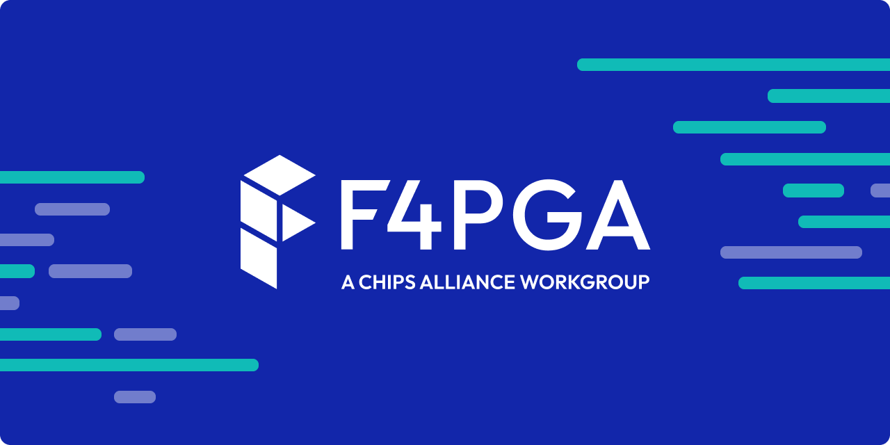
Project X-Ray
Project X-Ray documents the Xilinx 7-Series FPGA architecture to enable the development of open-source tools
Main goal is to provide sufficient information to develop a free and open Verilog to bitstream toolchain for these devices.
Minitests, designs viewed by a human in Vivado to gain better understand on how to generate useful designs
Experiments are like "minitests" except are only useful for a short period of time.
Fuzzers are the scripts which generate the large number of bitstream
F4PGA prjxray: https://github.com/f4pga/prjxray

Slide 8
nextpnr - A portable FPGA place and route tool
Portable FPGA place and route tool Same as yosys, can be fully built from source
YosysHQ - nextpnr https://github.com/YosysHQ/nextpnr
Lattice iCE40 devices supported by Project IceStorm https://github.com/YosysHQ/icestorm
Lattice ECP5 devices supported by Project Trellis Lattice MachXO2 devices supported by Project Trellis (experimental) https://github.com/YosysHQ/prjtrellis
Lattice Nexus devices supported by Project Oxide https://github.com/gatecat/prjoxide
Gowin LittleBee devices supported by Project Apicula https://github.com/YosysHQ/apicula
Intel Cyclone V devices supported by Mistral (experimental) https://github.com/Ravenslofty/mistral

Slide 9
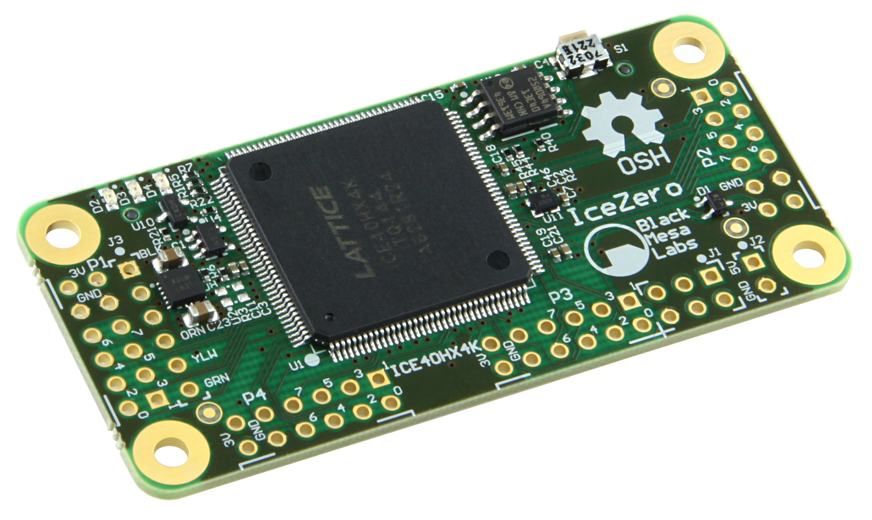

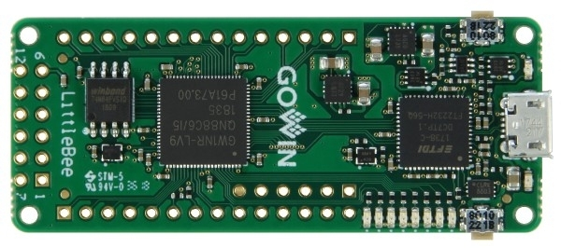


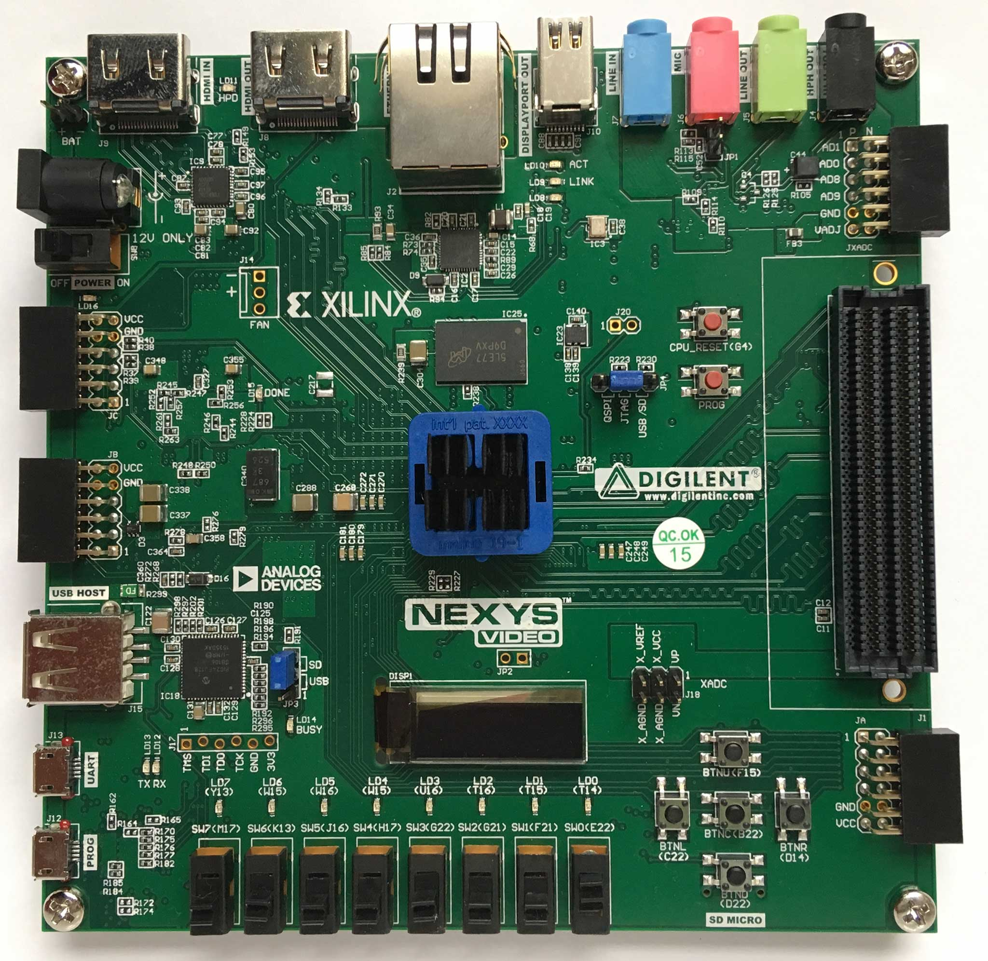

Supported FPGA Manufacturers
Lattice Semiconductors FPGAs ECP5 General Purpose FPGAs ICE40 Ultra Low Power FPGAs Nexus Ultra Low Power FPGAs https://www.latticesemi.com/Products/FPGAandCPLD/ECP5 https://www.latticesemi.com/Products/FPGAandCPLD/iCE40 https://www.latticesemi.com/solutions/solutions/solutionsdetails02/latticenexus
GOWIN FPGAs LittleBee Flash Based FPGAs https://www.gowinsemi.com/en/product/detail/46/
Altera (Intel) FPGAs MAX10 and Cyclone IV https://www.intel.com/content/www/us/en/products/details/fpga.html
Xilinx (AMD) Series 7 FPGAs 28nm Spartan, Artix, Kintex, Virtex 20nm UltraScale Artix, Kintex, Virtex 16nm UltraScale+ Artix, Kintex, Virtex https://docs.xilinx.com/v/u/en-US/7-series-product-selection-guide

Slide 10
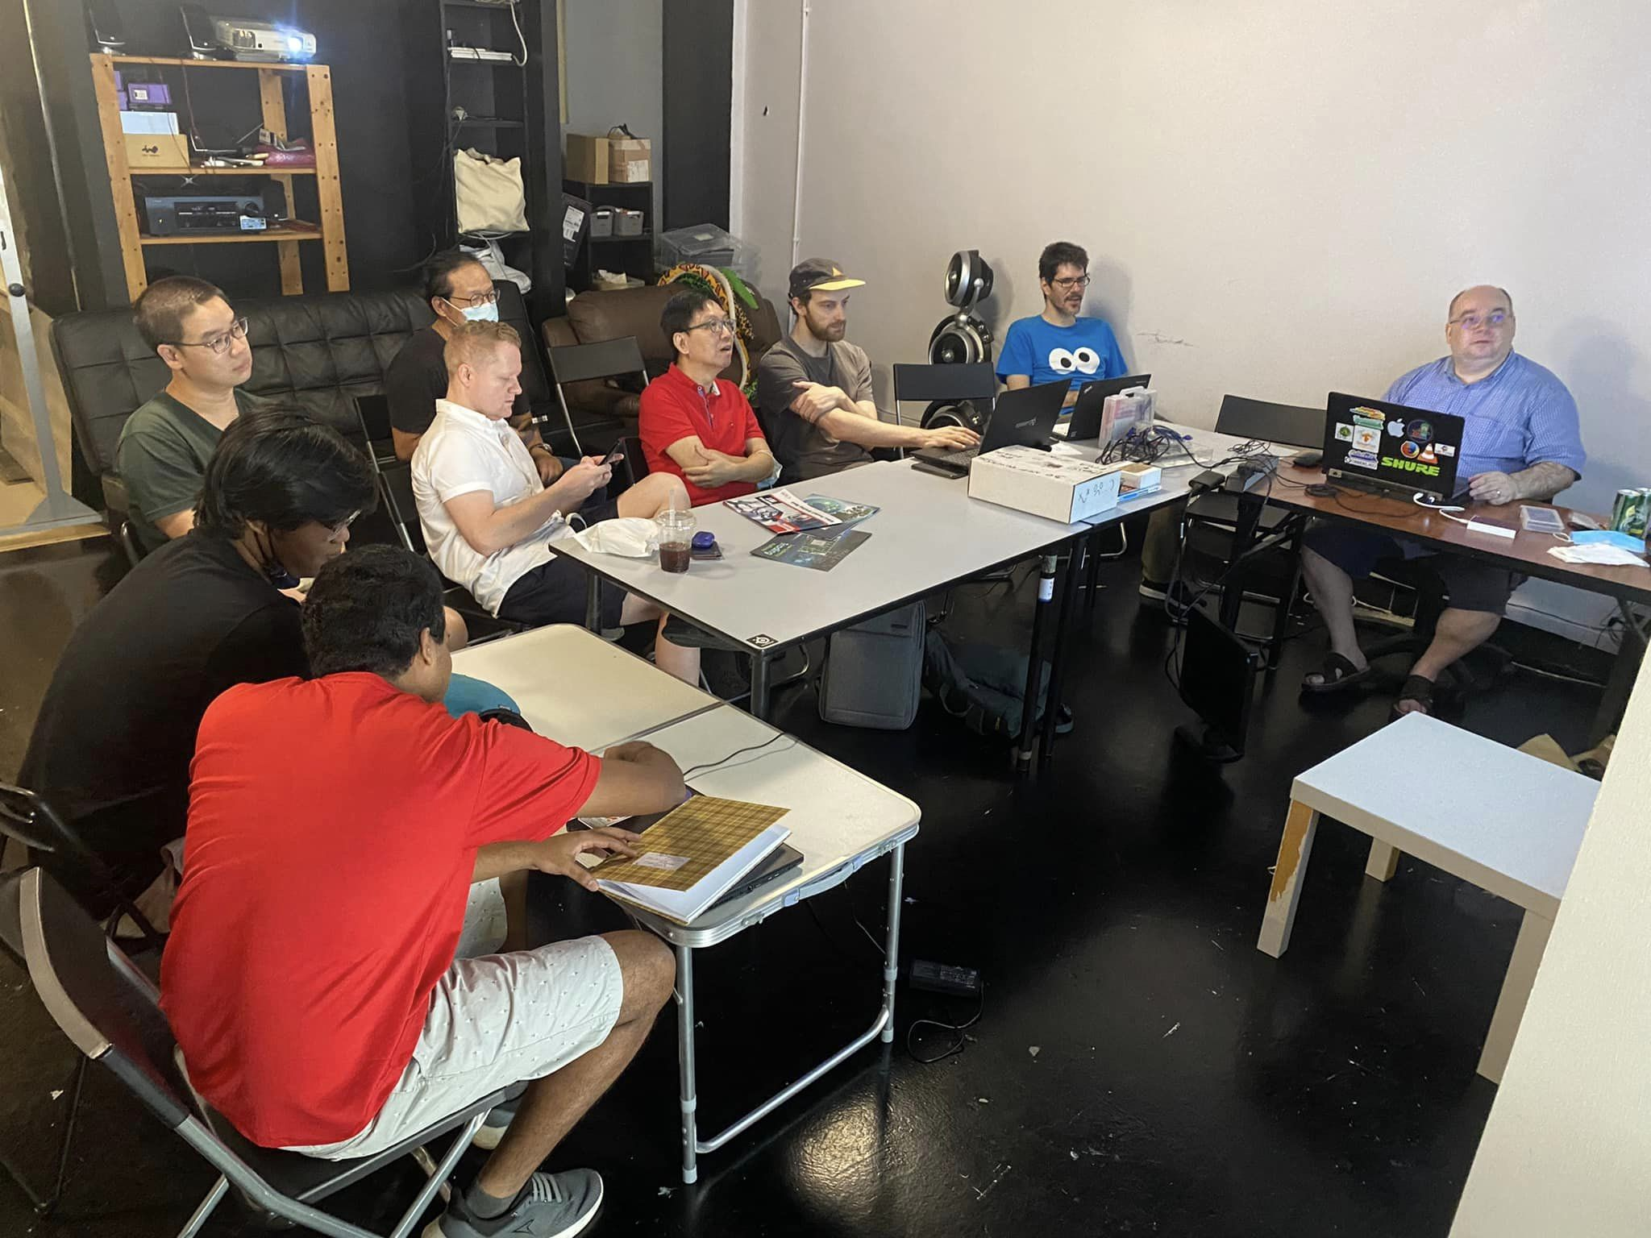
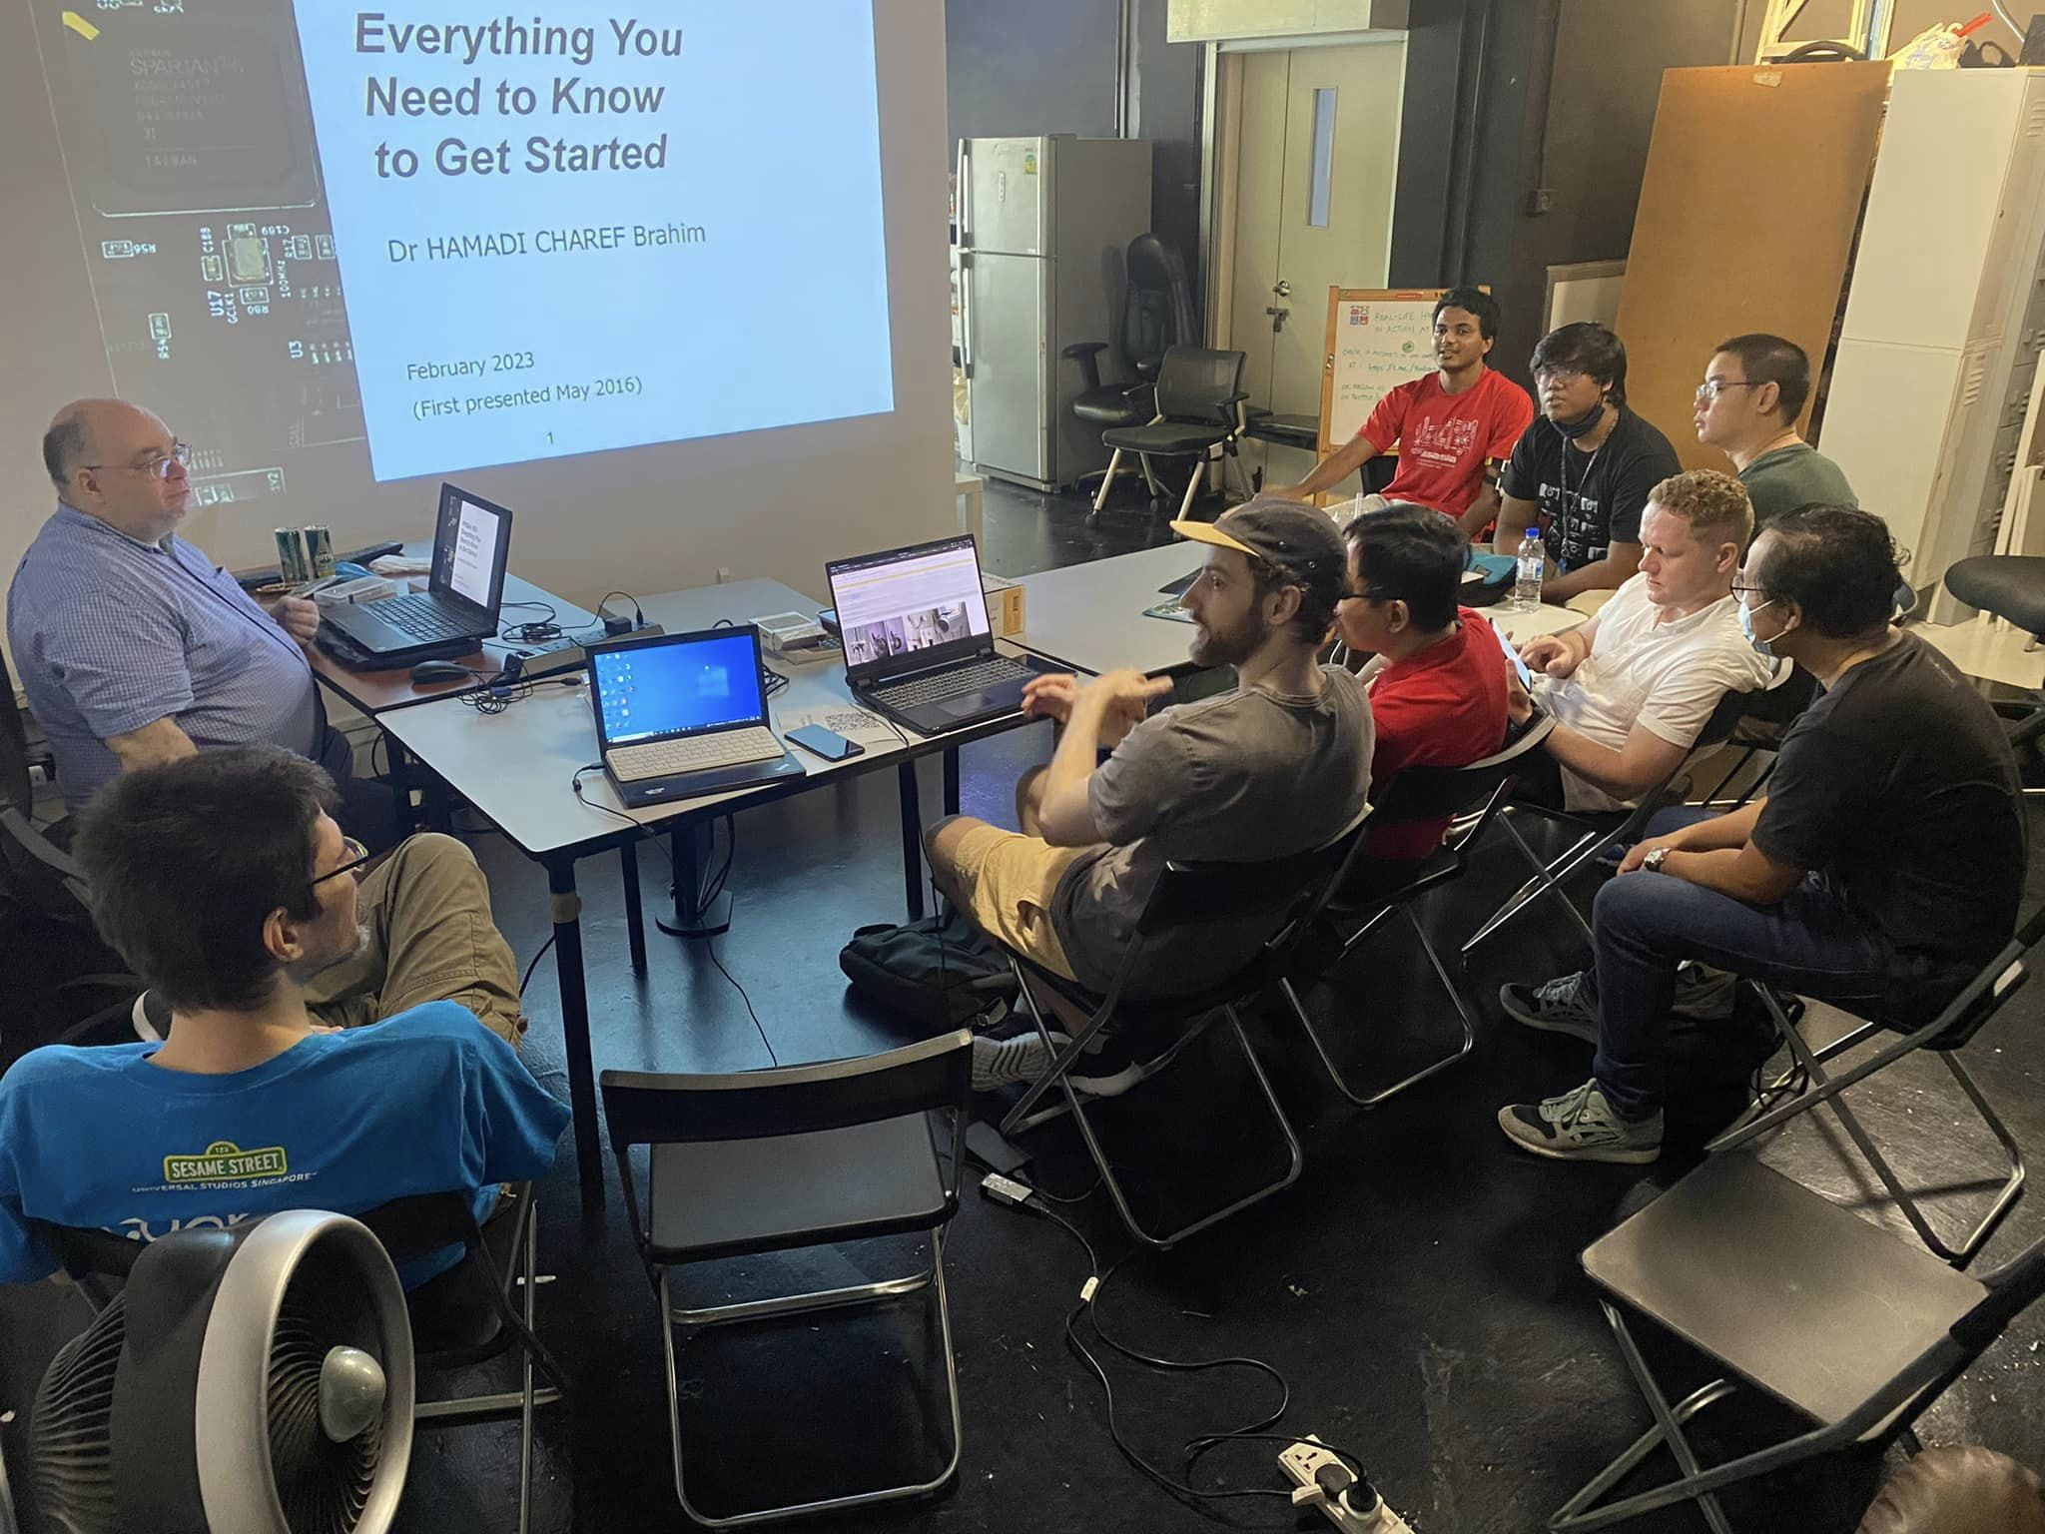
FPGA Community Singapore
Facebook FPGA Community Singapore https://www.facebook.com/groups/fpga.sg
"Hackware x FPGA Day" early July 2023 at Hackerspace.SG
Presentations/talks
Live demonstrations
FPGA applications

Slide 11
Paper We Love - Singapore Chapter
Yosys+nextpnr: an Open Source Framework from Verilog to Bitstream for Commercial FPGAs David Shah, Eddie Hung, Clifford Wolf, Serge Bazanski, Dan Gisselquist, Miodrag Milanović Proceedings of the 2019 IEEE 27th Annual International Symposium on Field-Programmable Custom Computing Machines (FCCM), San Diego, CA, USA, April 28 - May 1, 2019 DOI: https://doi.org/10.1109/FCCM.2019.00010
A Complete Open Source Design Flow for Gowin FPGAs Pepijn de Vos, Michael Kirchhoff, Daniel Ziener 2020 International Conference on Field-Programmable Technology (ICFPT), Maui, HI, USA, December 9-11, 2020 https://doi.org/10.1109/ICFPT51103.2020.00033
“Paper We Love” Singapore Chapter @ HackerSpace.SG https://paperswelove.org/chapter/singapore/

